Slide 1



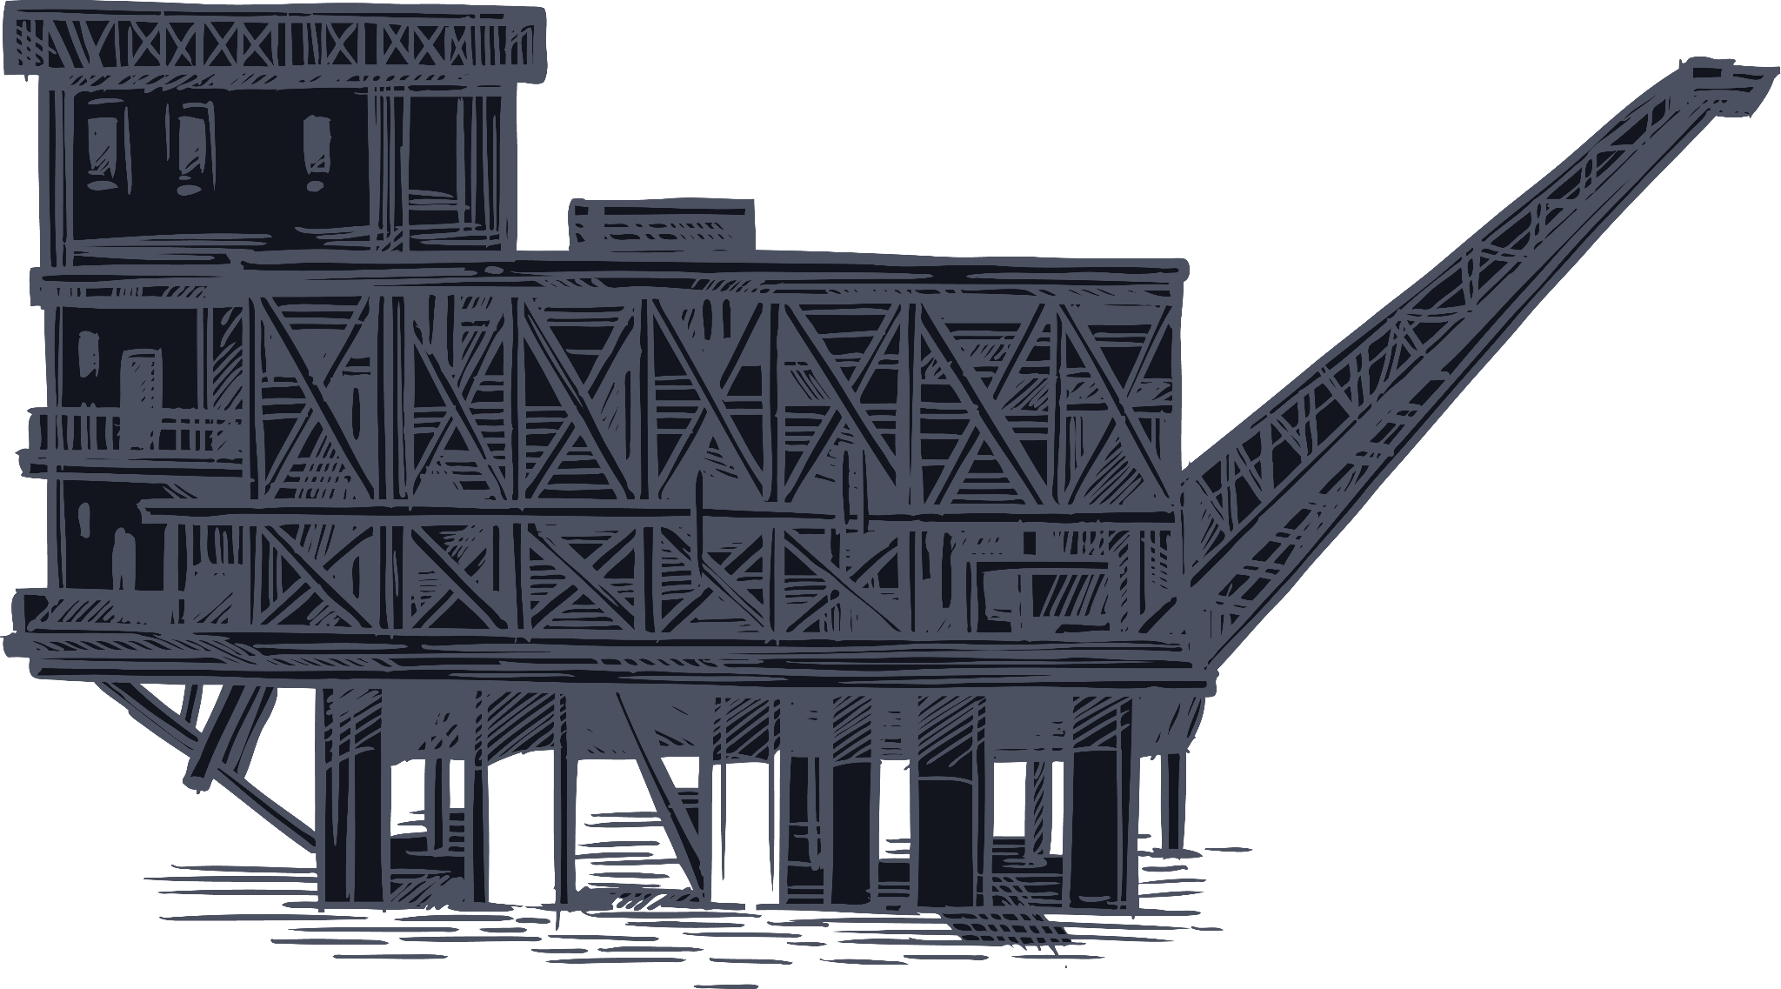

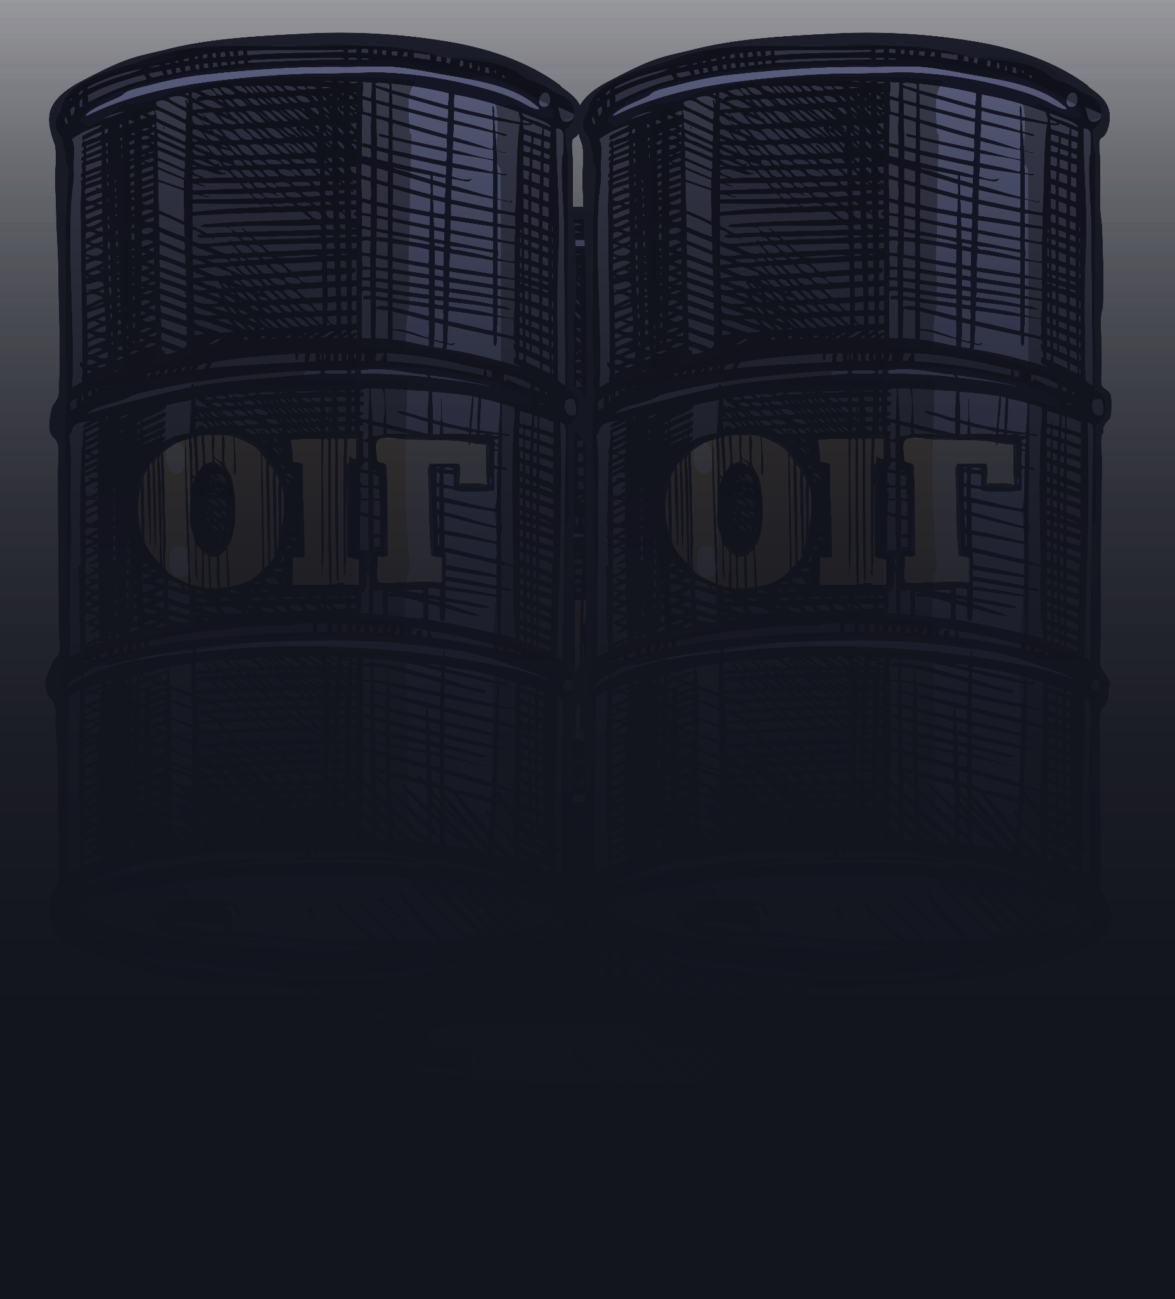
Hyperspectral Imaging For Oil Spill Detection
Project #7
Supervisor Luca Barco
Team 8 Mehdi Nickzamir , Mohammad Sheikh

Slide 2
Table of contents
01
02
03
04
05
06
Introduction
Value Proposition
Objectives
Design
Management Plan
Conclusions

Slide 3





01
Introduction

Slide 4

Introduction
How to achieve?
Why it is Important?
What are the Impacts?
Use hyperspectral imaging and machine learning
Improve oil spill detection accuracy.
Reduce detection costs.
Marine oil spills are a major threat to ecosystems.
Prompt and precise detection methods are necessary to address marine oil spills.
Supports proactive marine monitoring
aligns with environmental protection efforts

Slide 5
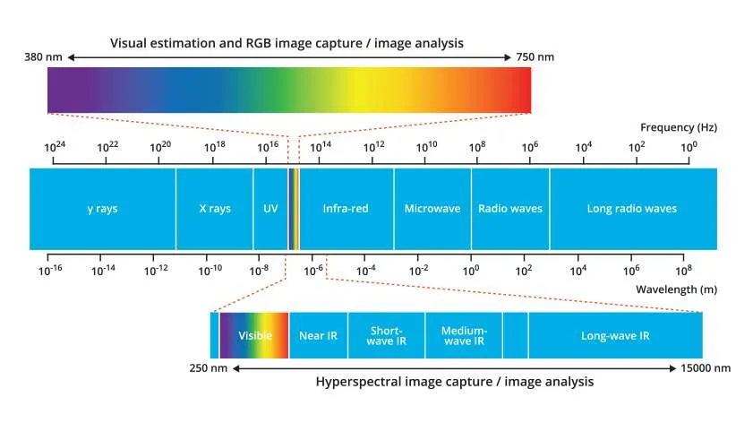
Hyperspectral images
Introduction
Captures hundreds of spectral bands vs. traditional camera's 3 RGB bands
Collects data beyond visible spectrum (infrared, ultraviolet)
Each pixel contains spectrum showing chemical/physical properties
Used in agriculture, environment monitoring, and medical imaging

Slide 6
Table of contents
01
02
03
04
05
06
Introduction
Value Proposition
Objectives
Design
Management Plan
Conclusions

Slide 7
02
Value Proposition
: Main stakeholders

Slide 8
Value Proposition
| Main stakeholders
LINKS Foundation
Oil and Shipping Companies
Oil Insurance Companies
Environmental Protection Bodies

Slide 9
Value Proposition
For
LINKS Foundation
seeks to develop and deploy innovative environmental monitoring technologies is an advanced machine learning and hyperspectral imaging platform enables rapid identification, tracking, and analysis of oil spills to support more effective cleanup and remediation efforts.
Who
Our oil spill detection solution
That

Slide 10
Value Proposition
For
Oil and Shipping Companies
face financial and reputational risks from oil spill incidents is an advanced analytics tool enables early detection, precise monitoring, and documentation of spills to mitigate liabilities, optimize response, and demonstrate environmental responsibility.
Who
Our oil spill detection solution
That

Slide 11
Value Proposition
For
Oil Insurance Companies
seek to minimize payouts and exposure for oil spill-related claims is a risk management platform delivers accurate, timely data to inform underwriting, claims processing, and policyholder risk profiles, leading to more sustainable insurance coverage.
Who
Our oil spill detection solution
That

Slide 12
Value Proposition
For
Environmental Protection Bodies
enforce regulations and safeguard the environment from oil spill impacts is a comprehensive, data-driven system provides real-time intelligence to support faster decision-making, better resource allocation, and more targeted environmental protection measures.
Who
Our oil spill detection solution
That

Slide 13
Table of contents
01
02
03
04
05
06
Introduction
Value Proposition
Objectives
Design
Management Plan
Conclusions

Slide 14
03
Objectives
: Main stakeholders

Slide 15

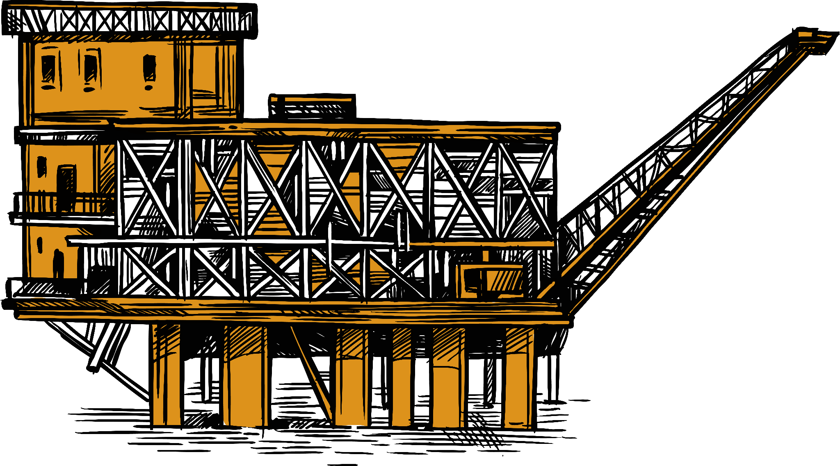
Objectives
Core Goal
Develop an unsupervised oil spill detection method using hyperspectral remote sensing to ensure timely detection to reduce environmental and financial costs
Sub-Objectives:
Gather a robust dataset of hyperspectral images for oil spill detection.
Implement an innovative machine learning approach
Validate performance against state-of-the-art methods.

Slide 16
Table of contents
01
02
03
04
05
06
Introduction
Value Proposition
Objectives
Design
Management Plan
Conclusions

Slide 17
04
Design
: Main stakeholders

Slide 18
Current Issues
Design
Problems
Lack of Data
Extensive Labeling
Noisy Data
Scarcity of annotated hyperspectral datasets for oil spill detection.
supervised methods require extensive labeling.
noisy spectral bands affecting detection accuracy.
Proposed Solution
Unsupervised detection method to minimize human intervention and enhance adaptability

Slide 19

Dataset Overview
01
02
03
Design
Source
compiled from the 2010 Gulf of Mexico oil spill using AVIRIS sensor data.
Size
18 images captured post-spill.
Validation
Human-labeled segmentation maps for validation.
04
Bands
Contain 224 bands that Covers a wide range of wavelengths (365-2500 nm).

Slide 20
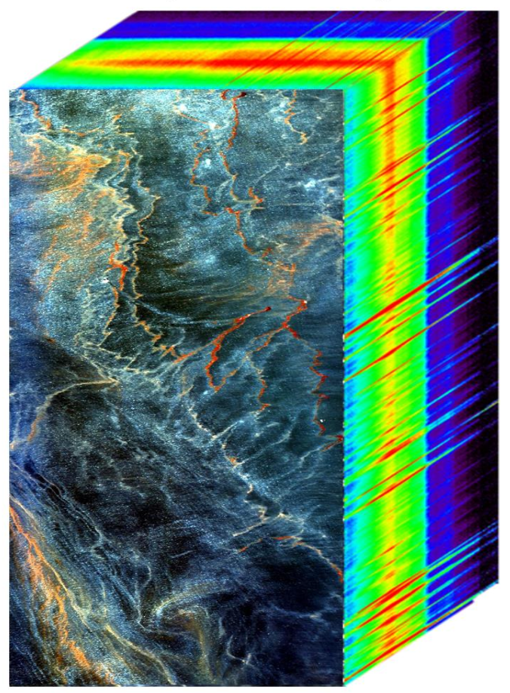
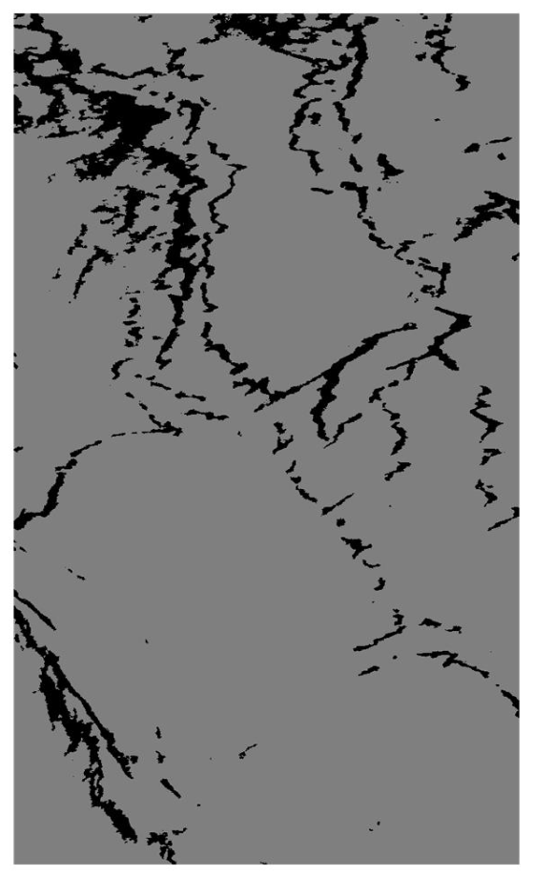
Functional Diagram
Design
Labeled
HSI Data of Mexican Gulf
Unlabeled
Mat file
Noise Reductor
Dimensionality Reduction (KPCA)
Data frame
Predicted Boundaries
Feedback
Supervisor
Team members
AI Model
Visualizer
Design and fine tune

Slide 21
Table of contents
01
02
03
04
05
06
Introduction
Value Proposition
Objectives
Design
Management Plan
Conclusions

Slide 22
05
: Main stakeholders
Management Plan

Slide 23
Work breakdown structure (WBS)
Management Plan
WP no | WP Title | Lead Name | P.week | Start Month | End Month
1 | Project Management | Mehdi | 1 | 01.11.24 | 20.01.25
1 | Project Setup | Mohammad | 1 | 01.11.24 | 14.11.24
2 | Initial Research | Mehdi | 1 | 01.11.24 | 14.11.24
3 | Implementation and Initial Results | Mohammad | 2 | 15.11.24 | 05.12.24
4 | Experimentation and Analysis | Mohammad | 2 | 06.12.24 | 09.01.25
5 | Paper Writing and Finalization | Mehdi | 3 | 20.12.24 | 20.01.25
Total |  |  | 10

Slide 24
Management Plan
| Gantt chart
Nov 1-15 | Nov 15 - 30 | Dec 1-15 | Dec 15-31 | Jan 1-15 | Jan 15 - 31
Task 1 | Project Setup and Initial Research |  | Nov 1 - Nov 14 |  | Completed
Task 2 | Implementation and Initial Results |  | Nov 14– Dec 5 |  | In progress
Task 3 | Experimentation and Analysis |  | Dec 6 - Jan 9 |  | To do
Task 4 | Paper Writing and Finalization |  | Dec 20 - Jan 20 |  | To do
Task 1
Task 2
Task 3
Task 4

Slide 25
Table of contents
01
02
03
04
05
06
Introduction
Value Proposition
Objectives
Design
Management Plan
Conclusions

Slide 26
06
: Main stakeholders
Conclusions

Slide 27
Conclusion
Proposed novel approach to oil spill detection combining hyperspectral imaging with unsupervised machine learning techniques
Identified key stakeholders and value propositions for environmental protection, shipping industry, and insurance sectors
Established detailed project roadmap for November 2024 - January 2025 with clear milestones and team responsibilities

Slide 28
The End !

